Slide 1
WELCOME!
May 5th
6th Sunday of Easter

Slide 2
Prelude and
Ringing of
the Church Bell

Slide 3
Welcome & Announcements
(Prayer Cards Collected)
Printed Announcements are on the
back table to take home.

Slide 4
May
Sermon Series
The Parables of Jesus

Slide 5
5/5 | Jesus’ Parable | The Parable of the Vine John 15:1-11
5/12 | Ascension Sunday Mothers’ Day | Mother’s Love
5/19 | Pentecost (Jesus’ Parable) | The Parable of the Ten Virgins Matthew 25:1-13
5/26 | Trinity Sunday (Jesus’ Parable) | The Parable of the Sheep and the Goats Matthew 25:31-46
April/May
Sermon
Series
The
Parables
of
Jesus

Slide 6
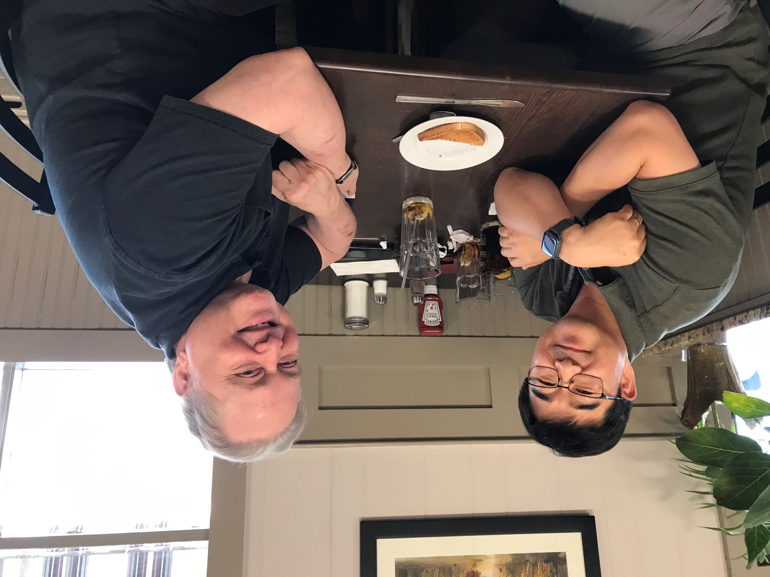
Pastoral Visitation
Pastor Sean would like to meet
with all Church Members
Tuesdays & Thursdays
in May.
Please see
Sign-Up Sheet
in the back of the Sanctuary.

Slide 7
Mother’s Day Honor Roll Forms
are DUE TODAY!
Honor or Remember your
Mother, Grandmother, Sister, Aunt!

Slide 8
NEXT WEEK IS FELLOWSHIP SUNDAY.
The theme is: PANCAKES!
Please Sign Up to bring something.
List is in the
back of the Sanctuary.

Slide 9
PRAYER LINE
Tuesday, May 14th
at 10AM

Slide 10
UNITED METHODIST WOMEN
Next Meeting:
Tuesday, May 21st at 6PM
Program:
“Stretch to the Heavens”
Part 1
Verse: 1 Corinthians 6:19-20
Speaker: Christine Zita

Slide 11
Next
COFFEE
HOUR
SUNDAY
is May 26th.
Please join us after service!

Slide 12
Choir Practices are Thursday evenings at 7PM.
If you are interested in singing in the choir,
please see Renee or any choir member.

Slide 13
I AM
HERE!
Please sign the attendance book at the end of your pew. Thank you!

Slide 14
FARMINGDALE CHRISTIAN DAYCARE CENTER
732-938-5657
Celebrating 52 years serving the Community!
​* Open year round, Monday-Friday 7AM-5:30PM *Accepting ages 2.5 - 6 years ​*Before and Aftercare available up to 10 years old *Flexible Part-Time & Full-Time Daycare spots to suit your needs

